Slide 1
Week-04:
Static (class variables and methods)
Getting Input
Getters and setters
Throwing Exceptions
Constructors
Encapsulation & Abstraction

Slide 2
Tell me all the differences between local and instance variables
Notes:
Local – declared inside of a method, stored in the current stack frame while program is running
Instance – declared at the class level, stored inside of an object which is stored in the heap

Slide 3
Tell me all the differences between local and instance variables
Local - declared inside of a method, stored in the current stack frame during runtime
Instance - declared at the class level, stored inside of an object which is stored in the heap
It turns out there is a third kind…
Notes:
Local – declared inside of a method, stored in the current stack frame while program is running
Instance – declared at the class level, stored inside of an object which is stored in the heap

Slide 4
Class Variables (also called Static variables)
Week-04:learningstatic:Start, Student

Slide 5
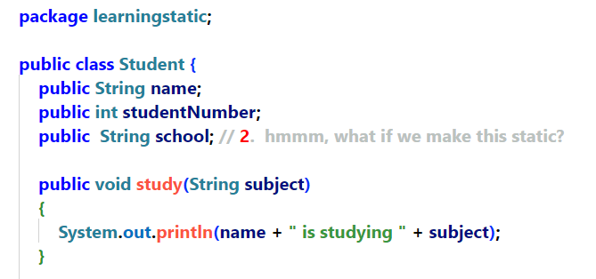
0: iconst_2 1: istore_1 2: iload_1 3: sipush 1000 6: if_icmpge 44 9: iconst_2 10: istore_2 0: iconst_2 1: istore_1 2: iload_1 3: sipush 1000 6: if_icmpge 44 9: iconst_2 10: istore_2
0: iconst_2 1: istore_1 2: iload_1 3: sipush 1000 6: if_icmpge 44 9: iconst_2 10: istore_2
0: iconst_2 1: istore_1 2: iload_1 3: sipush 1000 6: if_icmpge 44 9: iconst_2 10: istore_2
0: iconst_2 1: istore_1 2: iload_1 3: sipush 1000 6: if_icmpge 44 9: iconst_2 10: istore_2
0: iconst_2 1: istore_1 2: iload_1 3: sipush 1000 6: if_icmpge 44 9: iconst_2 10: istore_2
0: iconst_2 1: istore_1 2: iload_1 3: sipush 1000 6: if_icmpge 44 9: iconst_2 10: istore_2
0: iconst_2 1: istore_1 2: iload_1 3: sipush 1000 6: if_icmpge 44 9: iconst_2 10: istore_2
Student
name = “Lisa”
studentID = 11128
School = “Fanshaw”
Study (String subject):void
Student
name = “Bart”
studentID = 1928
School = “Sheridan”
s3 = @
Student
Study (String subject):void
name = “Millhouse”
studentID = 4567
School = “Humber”
s2 = @
s1 = @
Study (String subject):void

Slide 6
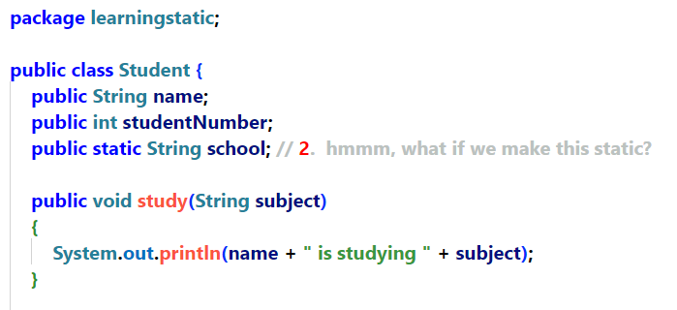
0: iconst_2 1: istore_1 2: iload_1 3: sipush 1000 6: if_icmpge 44 9: iconst_2 10: istore_2 0: iconst_2 1: istore_1 2: iload_1 3: sipush 1000 6: if_icmpge 44 9: iconst_2 10: istore_2
0: iconst_2 1: istore_1 2: iload_1 3: sipush 1000 6: if_icmpge 44 9: iconst_2 10: istore_2
0: iconst_2 1: istore_1 2: iload_1 3: sipush 1000 6: if_icmpge 44 9: iconst_2 10: istore_2
0: iconst_2 1: istore_1 2: iload_1 3: sipush 1000 6: if_icmpge 44 9: iconst_2 10: istore_2
0: iconst_2 1: istore_1 2: iload_1 3: sipush 1000 6: if_icmpge 44 9: iconst_2 10: istore_2
0: iconst_2 1: istore_1 2: iload_1 3: sipush 1000 6: if_icmpge 44 9: iconst_2 10: istore_2
0: iconst_2 1: istore_1 2: iload_1 3: sipush 1000 6: if_icmpge 44 9: iconst_2 10: istore_2
Student
name = “Lisa”
studentID = 1928
Study (String subject):void
Student
name = “Bart”
studentID = 1928
Student
s3 = @
Study (String subject):void
name = “Lisa”
studentID = 1928
s2 = @
Study (String subject):void
school = “Sheridan”
s1 = @

Slide 7
Static vs Instance Variables
Here is another way to think about static (class) variables:
Static variables only have one value which is shared by all the objects in the class. If we have a static variable called abc and 100 objects, there is still only one value for abc.
Instance variables are stored in every object that we instantiate. If we have an instance variable called def and 100 objects, there are 100 instance variables called def (one in each object)
Let's say we are writing a bank application. Every Account object must have its own account number (instance variable) but all Account objects can share the same interestRate value (static (class) variable).

Slide 8
Static
A global variable for a class
Never part of an object
Can be accessed using a reference variable but best to be accessed with the class name.

Slide 9
Just to be clear…Know this!!!
Kind of variable | declared in during design | Stored during runtime | notes
primitive | -- | -- | int, boolean, double etc.
reference | -- | -- | holds the address of an object that is on the heap
local | inside method | current stack frame | Scope inside of method only
instance | class level | object it was instantiated in | belongs to the instantiated object. If we write a class called Person with an instance variable called name and we instantiate 100 Person objects, each Person object will have its own name instance variable. Scope is the entire class.
class | class level | Static method section of memory | Uses static modifier - belongs to entire class. It is shared among all instances of the class and has the same value for all objects (doesn’t need to be instantiated)

Slide 10
Pop Quiz
What is stored in a primitive variable?
values
What is stored in a reference variable?
Address (or null)
Where is a primitive variable stored?
Don’t know…not enough information!
What is stored in an instance variable?
Don’t know…not enough information!
Where is an instance variable stored?
In each object
Where is a class variable stored?
In a single variable in the method area
How do we know the difference between a primitive and a reference?
Primitive type is lowercase (built into the language), reference type is Capitalized (instructions to build one is in a class)

Slide 11
So, it might be nice to ask users for information
So far, all of our code has hard-coded values into it.
To make our code more useful, we need to be able to ask the user for input!

Slide 12
Getting Input!
Week-04:gettingInput:Start

Slide 13
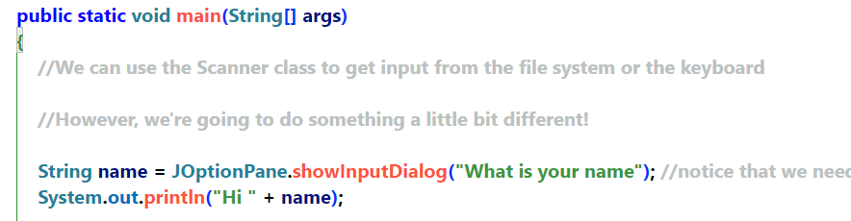
JOptionPane
Tell me everything you can about these two lines of code
Notes:
name is a local variable (stored in current stack frame on the stack)
Name is a reference variable – holds the address of a String Object.
Hmmm…those brackets should tell us something…
showInputDialog must be a method because of the brackets
JOptionPane must be a class because it starts with a Capital
But that isn’t how we normally do things, is it?

Slide 14
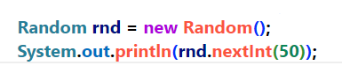
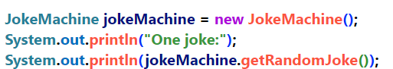
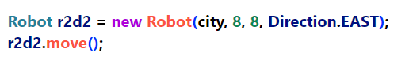
Here’s my question
If I want to call the nextInt method in the Random class, I have to instantiate an object first, don’t I?

Slide 15
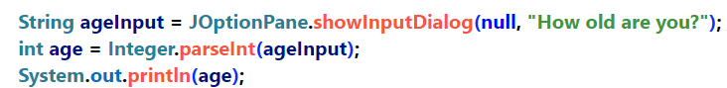
So….Why didn’t we need to Instantiate an Object to use showInputDialog or parseInt?
showInputDialog is a method in the JOptionPane class
parseInt is a method in the Integer class
println is also a method (more on that later)
So, why didn’t we need to instantiate a JOptionPane object or an Integer object in order to call these methods???
It looks like we just had to use the Class name and a .

Slide 16
The answer is STATIC!
Remember our main method had the static keyword in the method header?
Static method = No Objects
Static method= Global method for the Class (kinda!)

Slide 17
Static = NO Objects!!!
Any time the word static is used…we are not accessing any objects.
We are accessing the Class Bytecode directly in the Method area.
We can have static variables (Class variables) and Static Methods (Class Methods)
Since static = NO Objects, static means no STATE information

Slide 18
Static (Class) methods
Week-04:learningstatic:Start – Part B

Slide 19
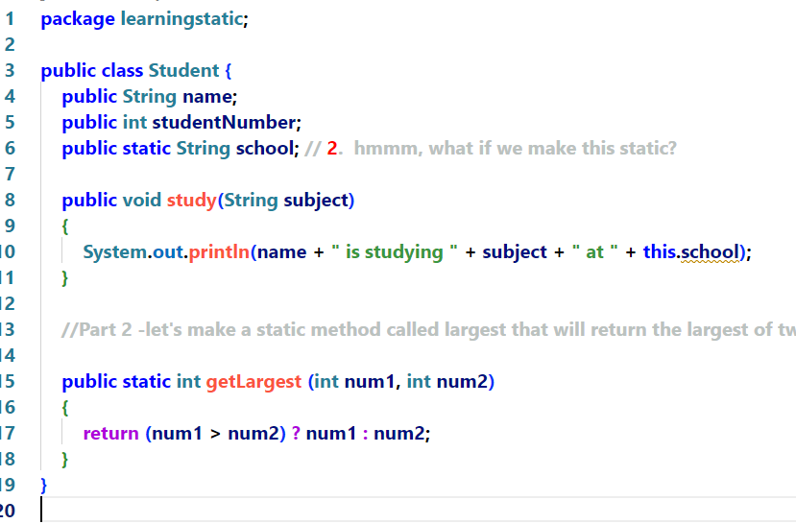
0: iconst_2 1: istore_1 2: iload_1 3: sipush 1000 6: if_icmpge 44 9: iconst_2 10: istore_2 0: iconst_2 1: istore_1 2: iload_1 3: sipush 1000 6: if_icmpge 44 9: iconst_2 10: istore_2
0: iconst_2 1: istore_1 2: iload_1 3: sipush 1000 6: if_icmpge 44 9: iconst_2 10: istore_2
0: iconst_2 1: istore_1 2: iload_1 3: sipush 1000 6: if_icmpge 44 9: iconst_2 10: istore_2
0: iconst_2 1: istore_1 2: iload_1 3: sipush 1000 6: if_icmpge 44 9: iconst_2 10: istore_2
0: iconst_2 1: istore_1 2: iload_1 3: sipush 1000 6: if_icmpge 44 9: iconst_2 10: istore_2
0: iconst_2 1: istore_1 2: iload_1 3: sipush 1000 6: if_icmpge 44 9: iconst_2 10: istore_2
0: iconst_2 1: istore_1 2: iload_1 3: sipush 1000 6: if_icmpge 44 9: iconst_2 10: istore_2
Notice that we use the class name to access this method
Notice, also, that we don’t travel through an object when calling this static method
Student
name = “Lisa”
studentID = 1928
Study (String subject):void
Student
name = “Bart”
studentID = 1928
s3 = @
Student
Study (String subject):void
name = “Lisa”
studentID = 1928
s2 = @
school = “Sheridan”
s1 = @
Study (String subject):void

Slide 20
Some Useful Static Methods
Don’t need to instantiate an object in order to use them!
Math.max (5,3);
Math.min (5,3);
Integer.parseInt(“125”);
Double.parseDouble (“125.5”);
Math.abs (-4);
Math.abs (4);
JOptionPane.showMessageDialog(null, “Please type name”);

Slide 21
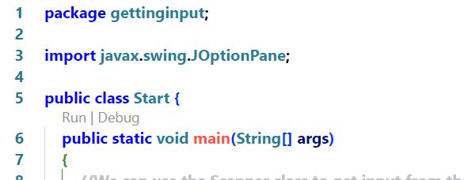
Hmmmm…what about main?
Notes:
Why do you suppose our main method must be static?
Answer – Because our program just started and there are no objects yet!

Slide 22
Making our Start Class into an object
Week-04:mainmethod:Start

Slide 23
Be careful…
Static has its place in OOP! Methods that will perform a calculation and return a value without the need to store any information can be safely made static.
However, remember that any method that we make static can no longer access any data (instance variables) inside of our objects.

Slide 24
Warning!!!
Anything static is not Object-Oriented!!!
Static has it’s uses and can be very helpful…
But beware of using static too much or you will end up writing procedural code and not OOP code.
A good rule of thumb is that if a method can be called without any need to access any instance variables, we might consider making it static.

Slide 25

Yourturn1 – Part A
Think of yourself as a detective!
You must use the clues in the Start class to write any required code to make the Start class work!

Slide 26
Week-04:
Encapsulation & Abstraction

Slide 27
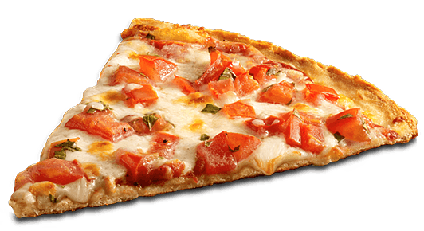
Mmmmm…Pizza!
Week-04:pizza:Start

Slide 28
Uh oh…Someone hacked our PizzaOrder!
If someone was able to set slices to a negative number, our bill would show that we owe them money!!!
Time to introduce an important law of programming…

Slide 29
secret rule of programming...
You never, ever, EVER want your code to fail!
It’s ok if other people’s code fails, but you don’t want your code to fail...It’s bad for your reputation...
So, you always want to check any value that another object is trying pass to your object before you set your instance variable.
Ya, whatever…Big deal…

Slide 30

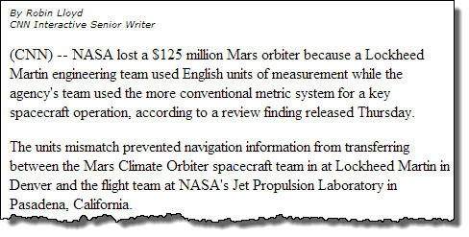
Why we make our instance variables private!!!

Slide 31
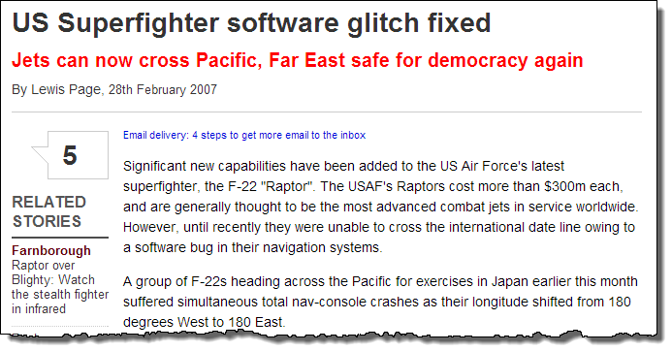
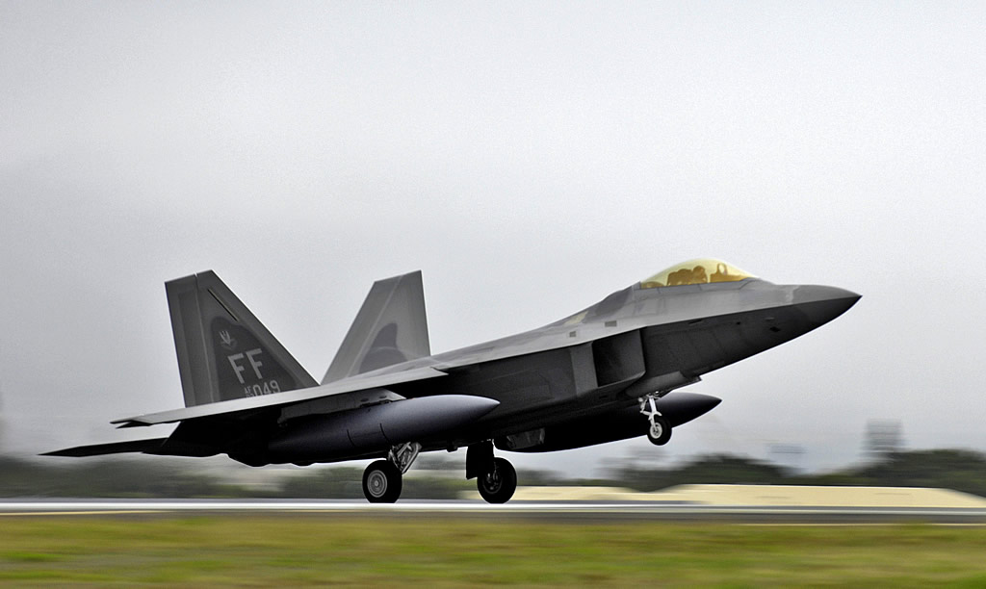

Slide 32
How does java protect itself from bad data?
Week04.badinput.Start

Slide 33
Let’s protect our PizzaOrder
Week-04:pizza:Start

Slide 34
Data shadowing and this
“Shadowing in Java is the practice of using variables in overlapping scopes with the same name where the variable in low-level scope overrides the variable of high-level scope. Here the variable at high-level scope is shadowed by the low-level scope variable. “
Remember, variables with different scopes can have the same name.
This can sometimes cause confusion.
In our Pizza class for instance…

Slide 35
There is a better way to treat instance variables
Make them private. (set the access modifier to private)
Now, no outside class can see the instance variable!!!
Create a public method that other classes can call to set the value of the instance variable.
Check the value that is being passed to your method before setting the instance variable. If the value doesn’t make sense, throw an exception!
Make a public method that other classes can call to get the value of the instance variable.

Slide 36
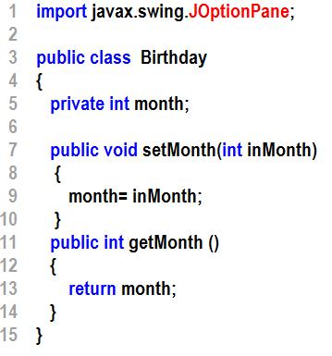
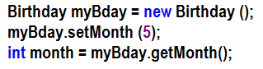
Introducing the getters and setters Pattern (also called accessors and mutators)
Instantiates the Birthday object and calls it myBday
Notice that month is private
(access modifier is set to private)
5
5
5

Slide 37
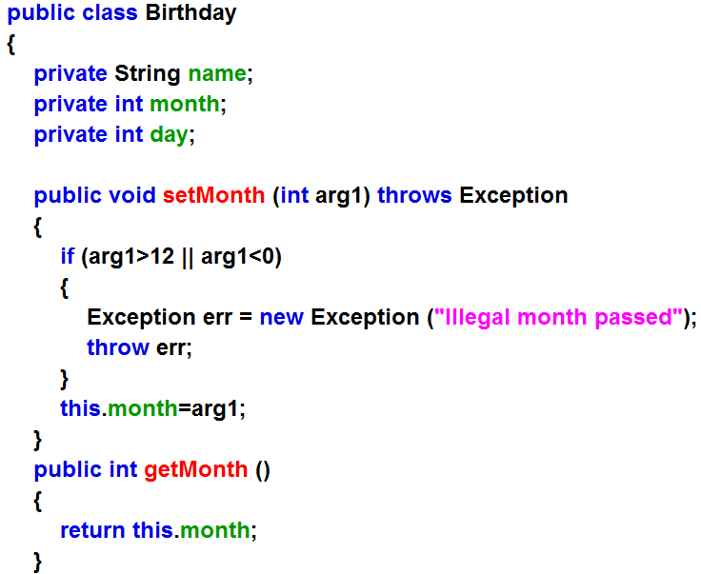
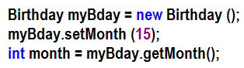
Using a Setter to validate incoming data
Instantiates the Birthday object and calls it myBday
5
5
F

Slide 38
Using a Setter to validate incoming data
5
5

Slide 39
Using a Setter to validate incoming data
Instantiates the Birthday object and calls it myBday
15
T
demo2

Slide 40
Naming Getters and Setters
If my variable is called counter,
getCounter
setCounter
If my variable is a boolean called unlocked
We can query this variable with
isUnlocked

Slide 41
What exactly is an Exception?
Week-04:learningexceptions:Start

Slide 42
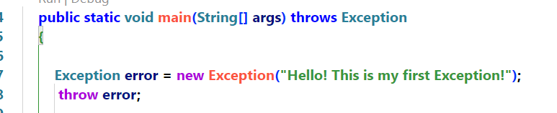
What exactly is an Exception?
Tell me everything you can about error?
Notes:
It is a local variable that is stored in the current stack frame on the stack
It is a reference variable of type Exception
It holds the address of an Exception Object which is sitting in the heap.
We are passing a String to the Exception Object’s Constructor (they don’t know this yet)
Throwing an exception will cause the JVM to terminate the execution of our code and display a Stack Dump

Slide 43
What exactly is an Exception?
When we ‘throw’ an Exception Object, the JVM will stop execution of the program and display a ‘Stack Dump’

Slide 44
Data Shadowing our pizza
Week-04:pizza:Start

Slide 45
Data Shadowing
Remember:
If two variable names collide, the JVM will always choose the variable with the smallest scope (usually the local variable).
The this. keyword allows you to force the JVM to use the instance variable instead
They picked the word this because we are referring to instance variables and methods in this object
In this (no pun intended) course will mostly use this in setters and constructors

Slide 46
yourturn2
10 mins

Slide 47
What was the first pillar of OOP again?
Abstraction:
The goal of abstraction is to reduce the complexity of our code by reducing our perspective or simplifying our model.
Only dealing with what is important to us in this particular situation.
Only showing what is important
More about abstraction when we learn about Inheritance

Slide 48
OOP Principle #2: Encapsulation
getters (accessors)
setters (mutators)
other member methods
name
age
We never expose our instance variables to other classes unless they are final.
Any object that wants to access our object must do it through methods.
Notes:
Encapsulation serves two big purposes:
It protects our data from being manipulated incorrectly from outside of the object.
It protects code outside of our object from needing to understand the internals of our object
Added benefit: We can change the code inside our object anytime we want as long as we keep the API (method names and parameters) the same and we won’t break the code calling it.

Slide 49
Encapsulation
Pig Latin is a constructed language game where words in English are altered according to a simple set of rules. Pig Latin takes the first consonant (or consonant cluster) of an English word, moves it to the end of the word and suffixes an ay (IPA [eɪ]) (for example, pig yields igpay, banana yields ananabay, and trash yields rashtay).
Study Hard!
udystay ardhay
This is our object…it was built using the code that we wrote in the Class
Black box (hides the implementation details)
Notes:
Pig Latin is a child’s game that allows children to talk to each other in their own, secret language. Encapsulation allows us to feed in a sentence to a well known interface and get the translated text out the other side, without need to understand the internals of the translator.

Slide 50
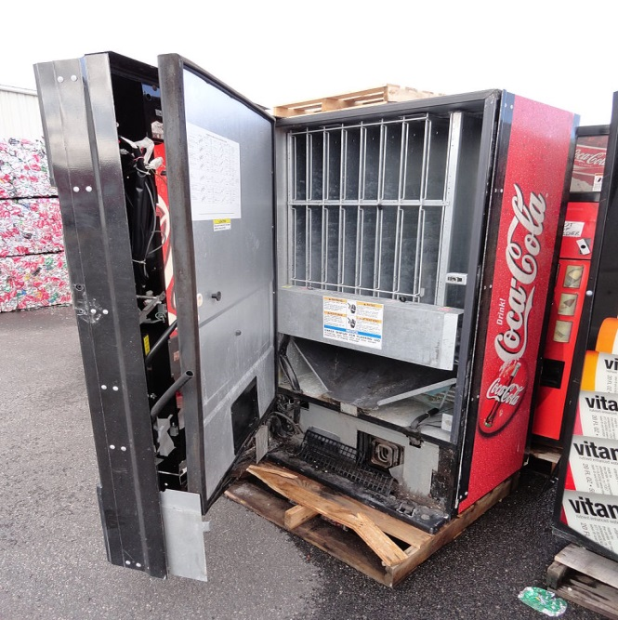

Encapsulation
Notes:
The point of this slide is that a Coke machine could be a bunch of pulleys and gears or it could be a magical land like the video. The point is that we don’t need to know in order to use the Coke machine

Slide 51
Encapsulation – the second pillar of OOP
Protects our code:
We make our instance variables private to protect our code. The only way our data can be accessed is through methods that we’ve written
This is known as Information Hiding
It prevents other programmers (or ourselves ;->) from messing up our object’s data

Slide 52
There is a second benefit of Encapsulation
What do you suppose it might be?
If we made our instance variables public, the programmer using our class would have to understand some of the internals of our code in the class.
For example, the programmer would have to know that he/she should never set our numSlices to a negative number.
Programmers should be able use our objects without having to understand how we wrote it.
This also allows us to change the internals of our code without breaking code that relies on it. This is important!
We are protecting our code from external misuse, but we are also protecting external programmers from need to understand our code.

Slide 53
Hmmmm…can you think of how abstraction might be used in our soda machine?
It probably make sense that the people that designed the soda machine would include interfaces and functionality that a repair person could activate when fixing or restocking the machine.
However, this functionality would be confusing to a customer, trying to buy a soda. Not only that, but the customer might break something if they start messing around with those extra functions.
So, even though there is a lot of extra functionality in the soda machine, everything but the interface to pay for and select a soda are abstracted out when facing the customer.

Slide 54
Who am I?
I am what a setter returns.
void (nothing)
I am what a getter returns
the same value type as the instance variable it is getting for
I am the access modifier that we should typically set instance variables to.
private
I am what it will cost you if you don’t learn getters and setters really well
marks

Slide 55
Who am I?
I am what we call a set of method codeblocks with the same name but able to accept a different number or type of arguments.
Overloaded
I am used to halt the execution of the code and print out a stack trace for debugging.
Exception
I am used to stop an exception from halting the program
try/catch
I am going to work really hard to learn getters and setters so that Rich doesn’t sneak up behind me and whack me in the head.
me

Slide 56
I am what will happen below…

Slide 57
I am what will happen below.
5

Slide 58
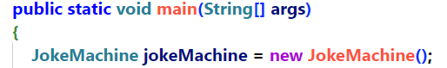
Did I mention Constructors?
So, tell me anything about this line of code:
Declaring a variable
???
Instantiating an object
Notes:
Declaring a local, reference variable of type JokeMachine, called jokeMachine, instantiating a JokeMachine object and placing the address of that object in the jokeMachine variable.
I get the variable declaration and I get that new causes the JVM to instantiate an object, but what about that last part: JokeMachine()?
Can you guess what JokeMachine() might be? Notice the ()

Slide 59
Did I mention Constructors?
So, tell me anything about this line of code:
This is our clue!
This must be a method call because of the ()
But, something’s not right? What is not right?
Method names don’t start with a CAPITAL letter.
Until now!
There is one special method that starts with a Capital
It is called a constructor.
A constructor runs automatically when an object is instantiated
Let’s check it out…

Slide 60
Constructors
Week-04:pizza
Notes:
Debug Start and show that the JVM jumps to the PizzaOrder class when we instantiate
Explain that, if we don’t explicitly write a Constructor, the compiler builds an empty one for us.
Build an empty constructor and debug again
Add a sout – Hi, from the constructor to make your point.
Add a full constructor – show that
Remove the empty constructor. Uh oh! Our code just broke! Discuss why the compiler doesn’t build us an empty constructor if we write any kind of explicit contstructor.
Finally, let’s use the static variable nextOrderNumber with an instance variable (orderNumber) in the constructor to make ever order have a unique orderNumber

Slide 61
Can I call my Setter from the Constructor?
A lot of students ask if it is ok to call the setter from the Constructor to make use of the data cops that we’ve set up in the setter.
This is a clever idea!
However, beware that you really shouldn’t get in this habit due to problems with multi-threading!

Slide 62
Yourturn1 – Part B
Think of yourself as a detective!
You must use the clues in the Start class to write any required code to make the Start class work!

Slide 63
There is no excuse…
Getters and Setters and contstructors will be involved in every quiz, every assignment, and every exam for the rest of the course…
You can spend 10 minutes to learn them now and get free marks or you can lose marks on everything you do for the rest of course.

Slide 64

Building a Safe for secret messages using abstraction and encapsulation
Week-04:safe:Start

Slide 65
Yourturn 3 & 4

Slide 66
Build more yourturns

